Slide 1
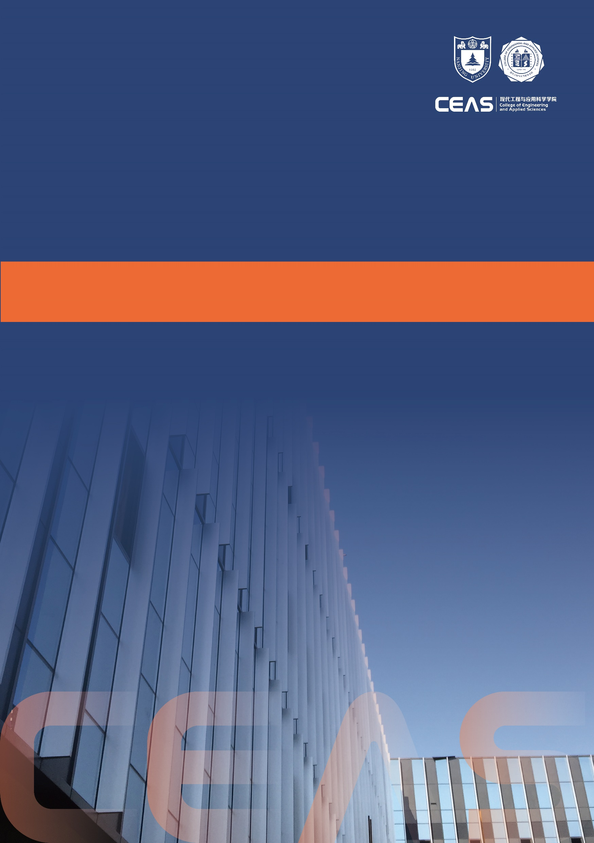
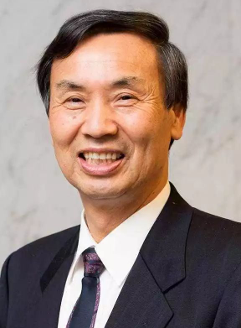
板东义雄
报告人单位、头衔等
讲座/论坛
报告时间
2023年5月25日 10:00
报告地点
南京大学现代工学院*****
通过电子显微镜的发展发现和创造新的纳米材料
报告摘要
The finding of BN nanotube by chance in 1996 triggered and since that time, various inorganic nanotubes, nanowires and nanosheets have been fabricated in his group. For the synthesis of BN nanotubes, his group successfully developed “the substitution reaction method” in 1996 and “the carbon free CVD method” in 2002. Moreover, his group developed “the chemical blowing method” for BN nanosheet. By the success of the high purity and the mass synthesis of BN nanotubes/nanosheets, the polymeric BN nanocomposites have been fabricated for the first time and it opened the new applications for insulating heat dissipating substrates as the high thermal conductivity.
报告人简介
Yoshio Bando received his PhD degree from Osaka University in 1975 and joined the National Institute for Research in Inorganic Materials (presently National Institute for Materials Science, NIMS) in the same year. From 1979–1981, he worked as a visiting researcher at Arizona State University. He has been a Fellow of NIMS until 2018. Currently, he is distinguished scientist at King Saudi University. He is also honorary professor at both the University of Wollongong and the University of Queensland. His research focuses on the construction of various inorganic nanostructures for energy and environmental applications. He has published more than 900 papers with > 67,000 citations and h-index > 138 (Web of Science). He was acknowledged as one of the Highly Cited Researchers in Materials Science from 2014 to 2021.

Slide 2

板东义雄
报告人单位、头衔等
讲座/论坛
报告时间
2023年5月25日 10:00
报告地点
南京大学现代工学院*****
通过电子显微镜的发展发现和创造新的纳米材料
报告摘要
The finding of BN nanotube by chance in 1996 triggered and since that time, various inorganic nanotubes, nanowires and nanosheets have been fabricated in his group. For the synthesis of BN nanotubes, his group successfully developed “the substitution reaction method” in 1996 and “the carbon free CVD method” in 2002. Moreover, his group developed “the chemical blowing method” for BN nanosheet. By the success of the high purity and the mass synthesis of BN nanotubes/nanosheets, the polymeric BN nanocomposites have been fabricated for the first time and it opened the new applications for insulating heat dissipating substrates as the high thermal conductivity.
报告人简介
Yoshio Bando received his PhD degree from Osaka University in 1975 and joined the National Institute for Research in Inorganic Materials (presently National Institute for Materials Science, NIMS) in the same year. From 1979–1981, he worked as a visiting researcher at Arizona State University. He has been a Fellow of NIMS until 2018. Currently, he is distinguished scientist at King Saudi University. He is also honorary professor at both the University of Wollongong and the University of Queensland. His research focuses on the construction of various inorganic nanostructures for energy and environmental applications. He has published more than 900 papers with > 67,000 citations and h-index > 138 (Web of Science). He was acknowledged as one of the Highly Cited Researchers in Materials Science from 2014 to 2021.

